Slide 1



Dynamic Price Floors
Final Deliverable
05 ● 04 ● 18

Slide 2








Team
Brian
Levis
Daniel
Grimshaw
Edric
Xiang
Forest
Hu
Ganesh
Jaladanki
Hermish
Mehta
Justin
Lu
Nilay
Khatore

Slide 3
Agenda
01 Introduction
02 Strategies
03 Results
04 Hand-off
05 Q & A

Slide 4
01
Introduction
Recap
Methodology

Slide 5

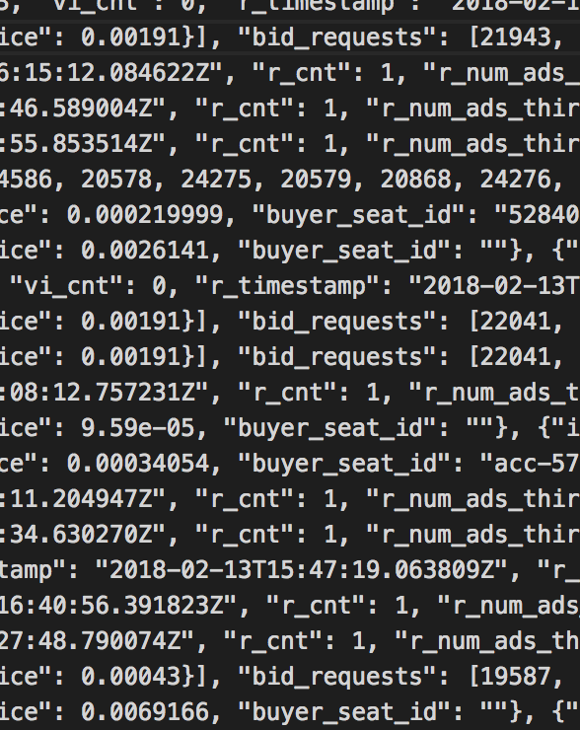



Recap
Data
We had 5 days of data, containing roughly one billion RTB auctions
We investigated several strategies for setting price floors based off of incoming bids
Q & A
Introduction
Strategies
Results
Hand-off

Slide 6



Recap
Assumptions & Caveats
We assumed we had access to every possible bid (if there was no price floor)
We were unable to calculate true revenue or even a baseline revenue, but we were able to compare strategies in a meaningful way
The vast majority of bid requests were not followed by bids (above the unknown price floor)
Q & A
Introduction
Strategies
Results
Hand-off

Slide 7

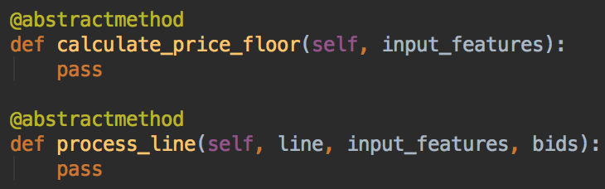

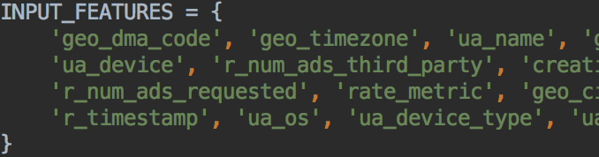

Methodology
Simulator
We tuned each strategy on 2/11-13, and tested on 2/14-15
Each strategy must return a price floor based on a set of input features
The bids above this price floor are then revealed to the strategy
Q & A
Introduction
Strategies
Results
Hand-off
Notes:
Some strategies require training on previous day’s data, and all require tuning of parameters.

Slide 8
02
Pricing Strategies
OneShot
Weighted Running Average
Optimization
Vowpal Wabbit
Random Forest
Running Average

Slide 9
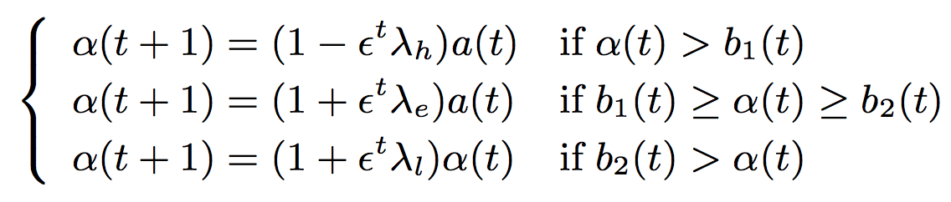

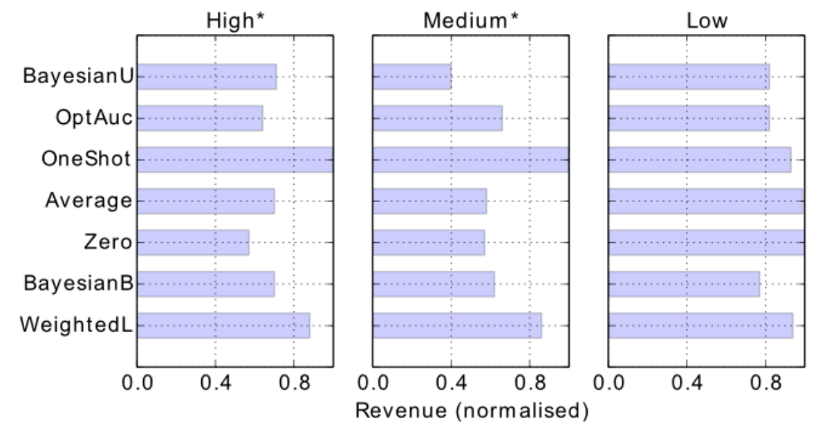


OneShot
Summary
Dynamically adjust price floor based on previous bid
λh: Price floor too high
λe: Price floor between max and second bid (ideal)
λl: Price floor too low
Responsively evolves over time to produce results
Q & A
Introduction
Strategies
Results
Hand-off

Slide 10

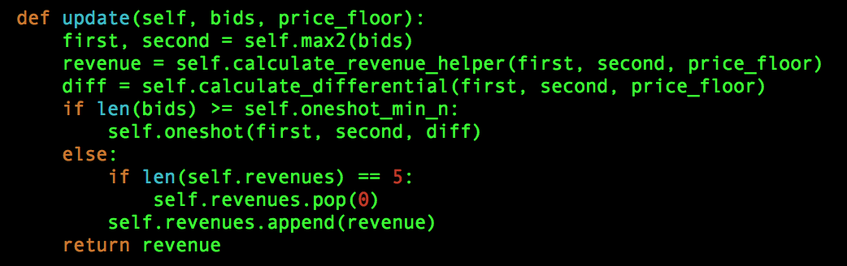


OneShot
Improvements and Experiments
Tuned hyperparameters for low overshoot rate
Adaptive price floor ceiling
Overshooting adjustments (λh)
Q & A
Introduction
Strategies
Results
Hand-off

Slide 11
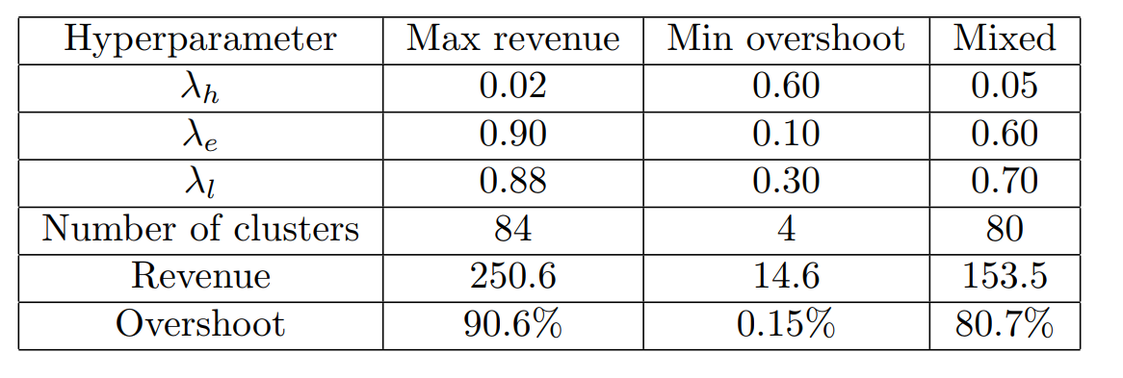
OneShot
Results / Numbers
Trade off between high revenue and low overshoot rate
Biased towards revenue in lieu of overshoot
Multishot method is extremely promising for quick results
Takeaways
Q & A
Introduction
Strategies
Results
Hand-off
Notes:
Boris

Slide 12
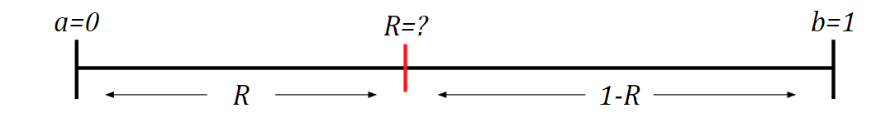

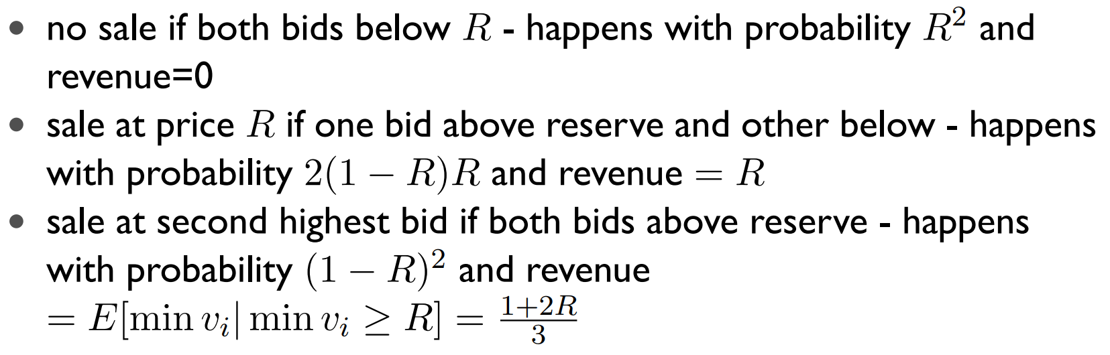

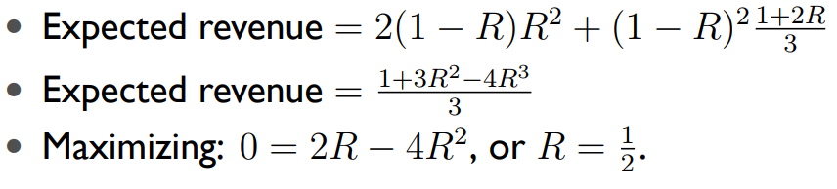
Weighted Running Average
Summary and Recap
Derived optimal price floor for two uniformly distributed bidders
Found optimal R=0.5, but tried weighing lower bid more to decrease overshoot rate
Split averages by features, keeping separate averages for site_id, pub_network_id, etc.
Q & A
Introduction
Strategies
Results
Hand-off

Slide 13


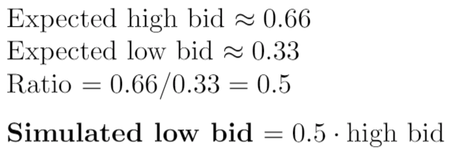

Weighted Running Average
Simulating Lost Bids
In real-life auction, bids below the price floor are lost
Lost bid information causes average strategy to strictly increase to unreasonable levels
Simulate lost bidders by deriving expected ratio between first and second bid using original assumptions
Q & A
Introduction
Strategies
Results
Hand-off

Slide 14
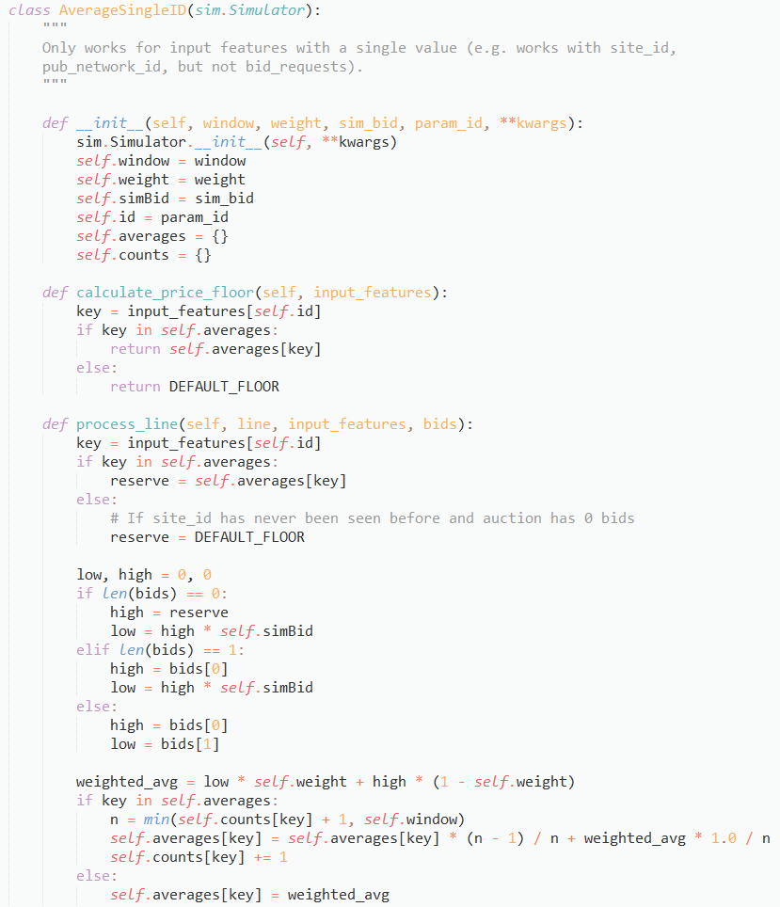

Weighted Running Average
Implementation
Parameters
window: number of past auctions to incorporate into average
weight: shift average toward low or high bidder
sim_bid: multiplier for generating simulated second bid using first
param_id: feature used to track separate running averages
Q & A
Introduction
Strategies
Results
Hand-off

Slide 15
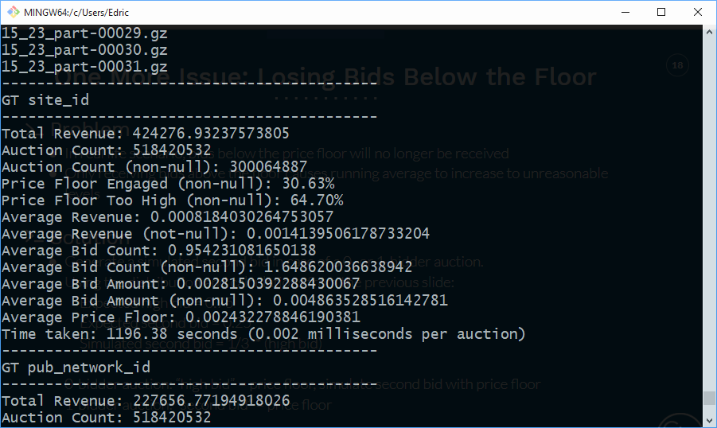
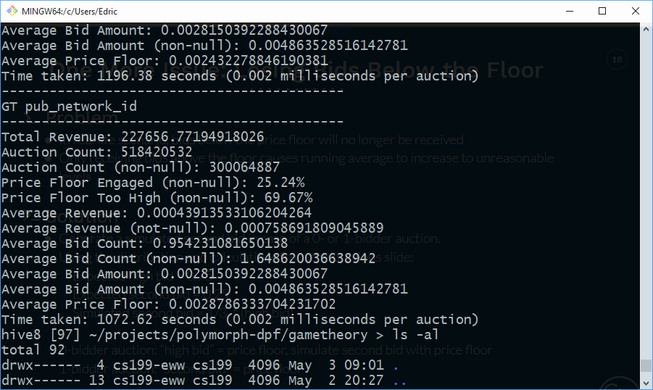
Weighted Running Average
Results
window=500, weight=0.6, sim_bid=0.3
Feature: site_id
Average Revenue: $0.0014
Engage / Too High: 30% / 64%
Feature: pub_network_id
Average Revenue: $0.0007
Engage / Too High: 25% / 69%
Q & A
Introduction
Strategies
Results
Hand-off
Notes:
Compare to:
No price floor: revenue=$0.0002, engage/too high=57%/ 0%
Basic running average: revenue=$0.0028, engage/too high=13%/87%

Slide 16
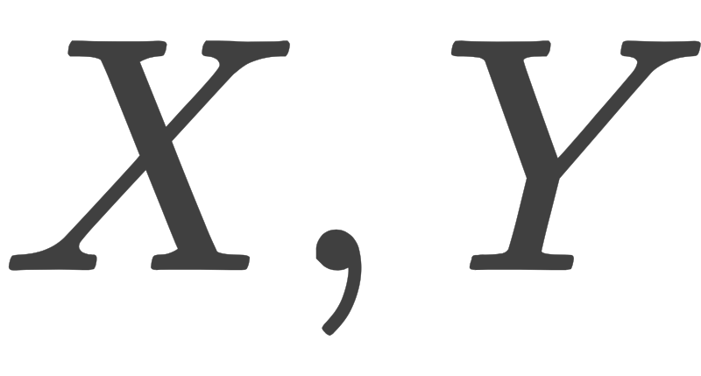
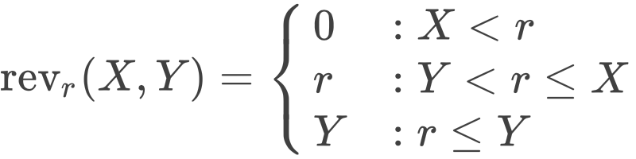
Optimization
Underlying Model
first and second highest bid distributions
set reserve price to maximize expected revenue
Q & A
Introduction
Strategies
Results
Hand-off

Slide 17
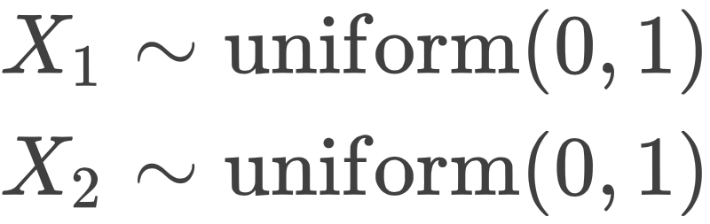
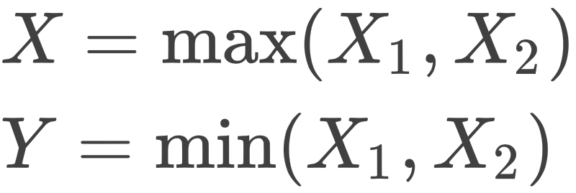
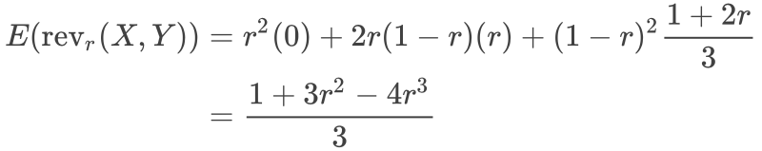
Optimization
Example
assume uniformly
distributed bidders
[function to maximize over r]
Q & A
Introduction
Strategies
Results
Hand-off

Slide 18

Optimization
Problem
?
what are bid distributions like?
second bid
more data, less structure principle
highest bid
Q & A
Introduction
Strategies
Results
Hand-off

Slide 19
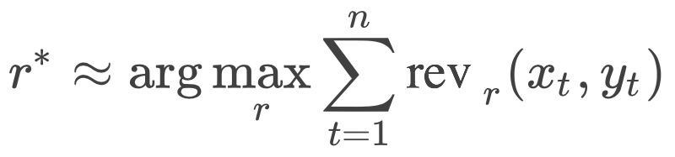
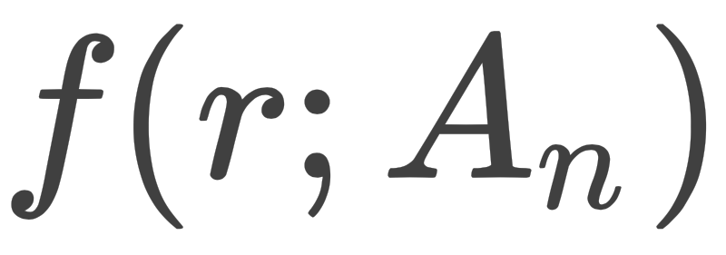
Optimization
Solution
empirical joint distribution
finding the maximum of this function
Q & A
Introduction
Strategies
Results
Hand-off

Slide 20
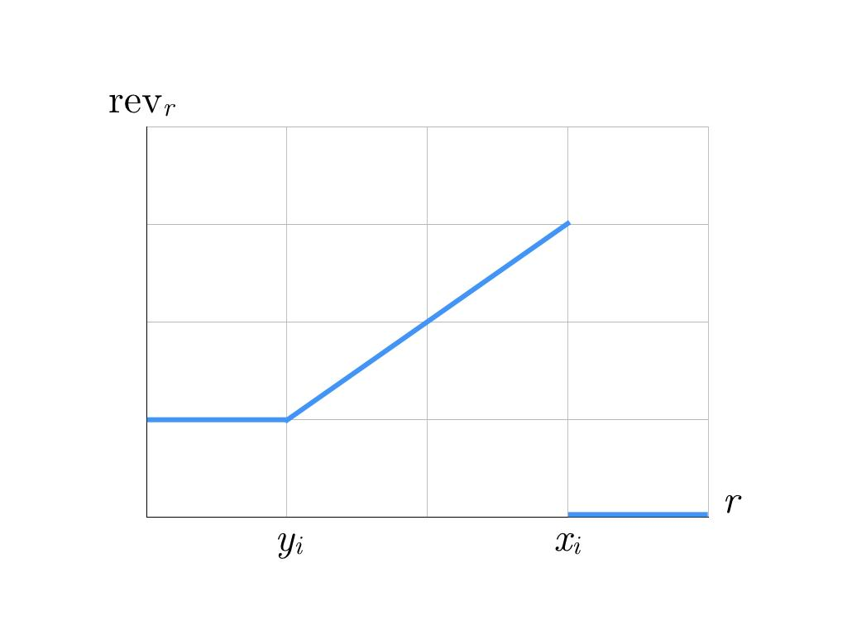
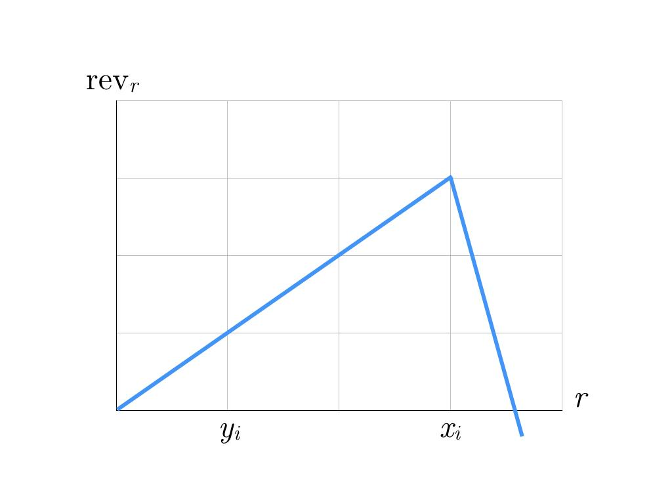
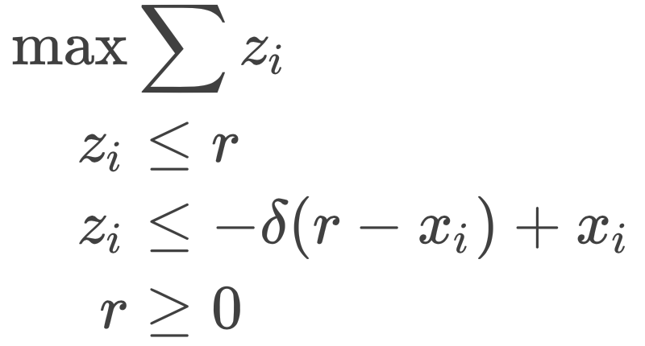
Optimization
Linear Heuristic
return γ · r*
revenue function
algorithm [γ , ẟ, n]
-approximation
Q & A
Introduction
Strategies
Results
Hand-off

Slide 21


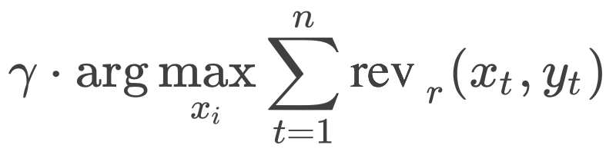
Optimization
Brute Force
try all drop points
algorithm[γ, n]: return
Q & A
Introduction
Strategies
Results
Hand-off

Slide 22
Optimization Results
Tuning
linear heuristic[γ, ẟ, n]: Fix n as 30, find γ and ẟ separately
brute force[γ, n]: Fix n as 100, find γ by varying
}
test on three files, best algorithms:
linear heuristic[1, -2, 30]
brute force[1, 100]
Q & A
Introduction
Strategies
Results
Hand-off

Slide 23
Optimization Results
Results
 | Period | Price Floor Engaged (non-null auctions) | Price Floor Too High (non-null auctions) | Average Revenue (non-null auctions) | Average Price Floor | Latency
 | 2 minutes 6 minutes 24 hours | 6.25% 7.79% 5.69% | 93.36% 92.20% 94.31% | $3.00 CPM $3.69 CPM $2.11 CPM | $48.34 CPM $47.47 CPM $39.36 CPM | 25.6 ms 8.35 ms 0.004 ms
linear heuristic
brute force
weighted average
Q & A
Introduction
Strategies
Results
Hand-off

Slide 24
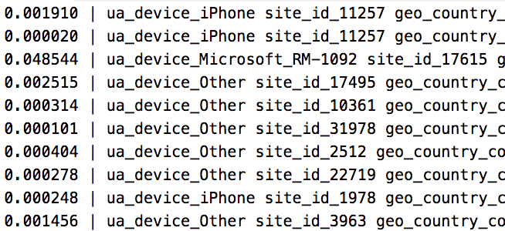
Vowpal Wabbit
Recap
Predict optimal price floor using bidder features
Strategy: machine learning framework to develop model
Use multipliers to get as close to highest bid as possible
Q & A
Introduction
Strategies
Results
Hand-off

Slide 25


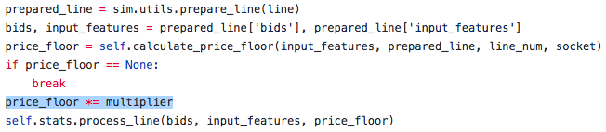
Vowpal Wabbit
Implementation
Used Vowpal Wabbit: fast ML framework
Parameters
1-pass model: campaign_id, site_id, zone_id
1-5 pass models: hashed features
Trained on Feb 11-13
price_floor = multiplier * b₁ prediction
Q & A
Introduction
Strategies
Results
Hand-off

Slide 26
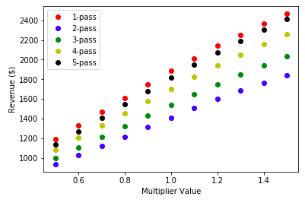
Vowpal Wabbit
Results
Tested on Feb 14, 12 AM
Multipliers ∈ [0.5, 1.5]
1-5 pass models
Higher multipliers ∈ [2.0, 4.0]
1-pass model
Multiplier | Revenue ($)
2.0 | 11,183.74
2.5 | 11,694.98
3.0 | 11,789.79
3.5 | 11,246.78
4.0 | 10,333.79
Optimum multiplier ≈ 3
Revenue (Feb 14-15): $223,703.77
Engagement: 43.89%
Q & A
Introduction
Strategies
Results
Hand-off

Slide 27
Vowpal Wabbit
Takeaways
Disadvantages:
Slower than other strategies
Assumptions made
Must train offline
Advantage:
Great potential with finely tuned model
High price floor engagement
Can be trivially parallelized
Q & A
Introduction
Strategies
Results
Hand-off

Slide 28
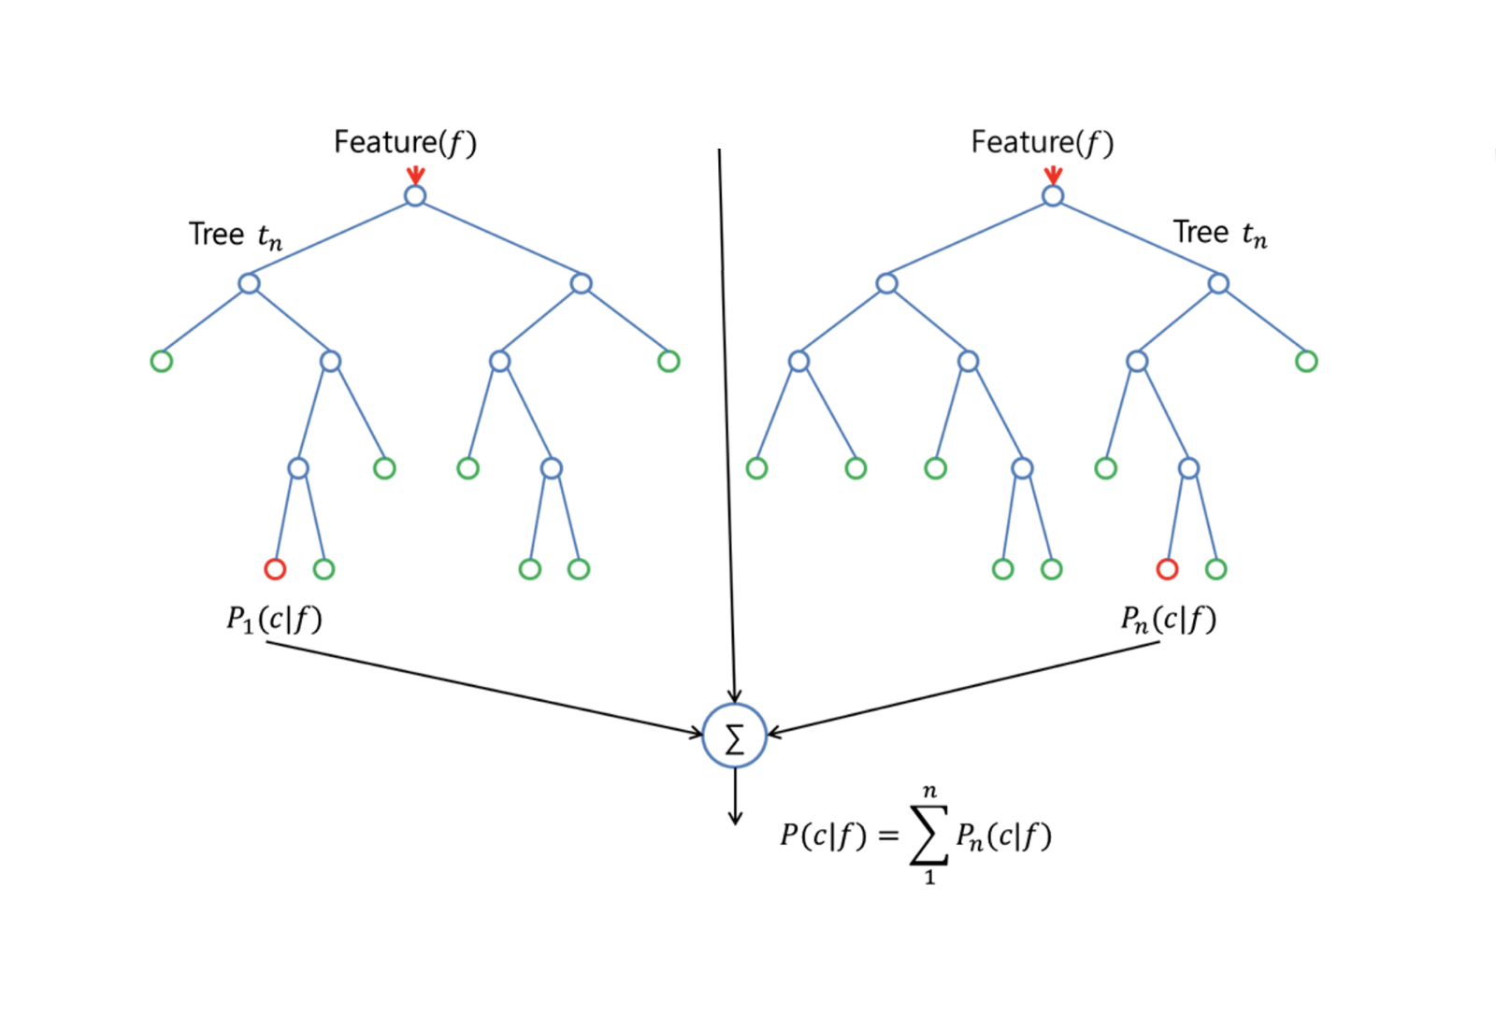
Random Forests
Classification
Bids are distributed tri-modally
k-means bins from 1 day of data
RF selected one bin for all auctions
Q & A
Introduction
Strategies
Results
Hand-off

Slide 29
Random Forests
Regression
Labels derived from game theory
State space is large
83% of predictions above optimal
Q & A
Introduction
Strategies
Results
Hand-off

Slide 30



Running Average
Experiments
Global running average
Running average for each site_id or publisher_id
Include auctions with no bids?
Q & A
Introduction
Strategies
Results
Hand-off

Slide 31
Running Average
Auction Count: 518420532
Auction Count (non-null): 300064887
Average Bid Count: 0.954231081650138
Average Bid Count (non-null): 1.648620036638942
Average Bid Amount: 0.0028150392288430067
Average Bid Amount (non-null): 0.004863528516142781
Results
Running Average Without Zeros
Total Revenue: 485298.0741042547
Price Floor Engaged (non-null): 7.73%
Price Floor Too High (non-null): 92.27%
Average Revenue: 0.0009361089003015311
Average Revenue (not-null): 0.0016173104389393441
Average Price Floor: 0.02089341090786549
Time taken: 1598.51 seconds (0.003 milliseconds per auction)
Running Average Including Zero-Bids
Total Revenue: 633231.2406333139
Price Floor Engaged (non-null): 5.69%
Price Floor Too High (non-null): 94.31%
Average Revenue: 0.0012214625030192937
Average Revenue (not-null): 0.0021103143622176425
Average Price Floor: 0.039357196287724196
Time taken: 2126.88 seconds (0.004 milliseconds per auction)
Per-Site Average
Total Revenue: 585769.6258170931
Price Floor Engaged (non-null): 35.06%
Price Floor Too High (non-null): 55.92%
Average Revenue: 0.0011299120880827558
Average Revenue (not-null): 0.0019521431903396717
Average Price Floor: 0.003797489056934269
Time taken: 1838.94 seconds (0.004 milliseconds per auction)
Per-Site Average Including Zero-Bids
Total Revenue: 823332.5974897781
Price Floor Engaged (non-null): 6.11%
Price Floor Too High (non-null): 93.88%
Average Revenue: 0.0015881558438927302
Average Revenue (not-null): 0.0027438485246352004
Average Price Floor: 0.17501760124503202
Time taken: 2194.64 seconds (0.004 milliseconds per auction)
Q & A
Introduction
Strategies
Results
Hand-off

Slide 32
03
Results
Comparison
Recommendations

Slide 33
Comparison of Best-Performing Strategies
Takeaways
Strategy | Revenue | Price Floor Engaged (non-null auctions) | Price Floor Too High (non-null auctions) | Average Revenue (non-null auctions) | Average Price Floor | Latency
Running Average (per site, with nulls) | $823,332 | 6.11% | 93.88% | $2.74 CPM | $175.02 CPM | 0.004 ms
Running Average (grouped by site) | $585,769 | 35.06% | 55.92% | $1.95 CPM | $3.79 CPM | 0.004 ms
OneShot | $339,306 | 5.27% | 94.71% | $1.13 CPM | $29.85 CPM | 0.017 ms
Weighted Average (grouped by site) | $424,276 | 30.63% | 64.70% | $0.82 CPM | $2.43 CPM | 0.002 ms
Vowpal Wabbit | $223,703 | 43.89% | 25.92% | $0.75 CPM | $8.93 CPM | 0.156 ms
No Price Floor | $49,862 | 61.56% | 0.00% | $0.17 CPM | $0.00 CPM | 0.001 ms
Results are from 518 million auctions from 02/13/18 12:00 AM - 2/15/18 12:00AM. 300 million auctions received at least one visible bid. 120 million auctions received at least two visible bids. Latency varies by machine, but results show that these methods have good computational performance.
Q & A
Introduction
Strategies
Results
Hand-off
Notes:
So here are some results from our top-performing strategies! Remember that with DPF in place, our data might look a little different, and the number of bids we see is dependent upon the strategy Almost half of our auctions had no visible bids, so even though there is a large discrepancy between revenues, I think each strategy on this table is quite promising.

Slide 34

Recommendations
Implementation Suggestions
Collect a testing dataset that disables price floors and can produce accurate revenue estimates
Implement A/B testing or similar to compare approaches
All strategies are promising, and will behave differently towards a real bid distribution
Q & A
Introduction
Strategies
Results
Hand-off

Slide 35
04
Hand-off
Materials
Next Steps

Slide 36
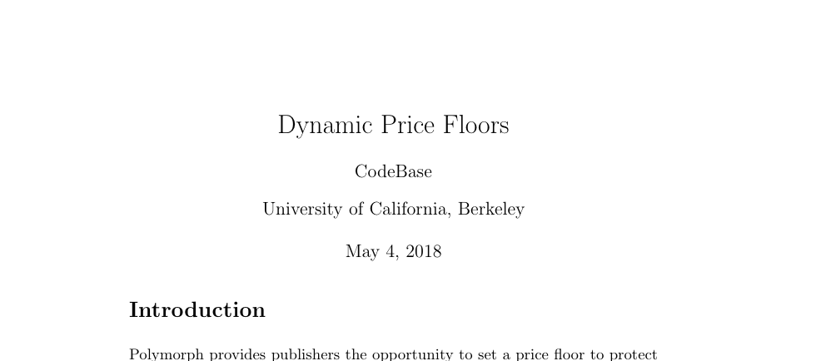
Materials
Report
Q & A
Data Processing
Machine Learning
Takeaways
Hand-off

Slide 37
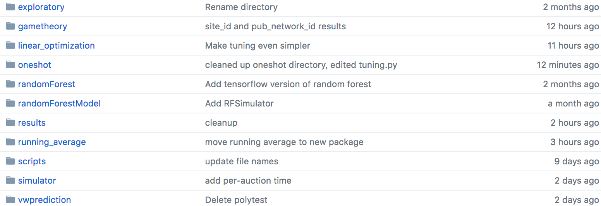
Materials
Code
Q & A
Data Processing
Machine Learning
Takeaways
Hand-off

Slide 38
Next Steps
Maintenance
We will be available for two additional weeks to answer questions, fix issues, and help you reproduce our results or implement strategies!
Q & A
Data Processing
Machine Learning
Takeaways
Hand-off

Slide 39
05
Q & A

Slide 40
Q & A
Q & A
Data Processing
Machine Learning
Takeaways
Hand-off

